Slide 1
Introduction to containers
How to get software to run reliably when moved from one computing environment to another:
• From a developer's laptop to a test environment,
• From a physical machine to a virtual machine in a cloud.

Slide 2
Containers are the solution
A container consists of an entire runtime environment:
an application, all its dependencies, libraries, binaries,
configuration files … bundled into one package.
• Containers encapsulate components of application logic. These components are provisioned only with the minimal resources needed to do their job.
• Unlike virtual machines (VM), containers have no need
for embedded operating systems (OS); calls are made
for OS resources via an application programming
interface (API)

Slide 3
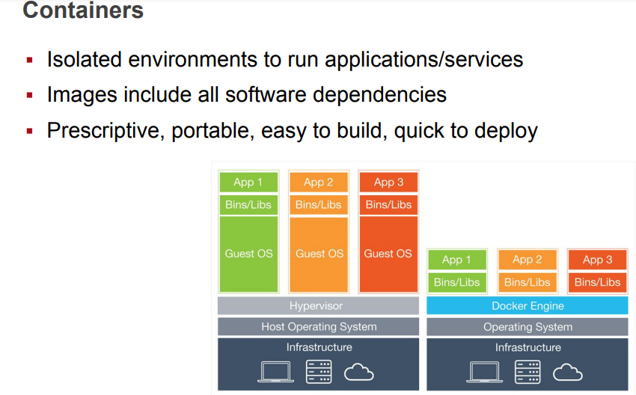
Containers are the solution

Slide 4
Virtualization vs. “containerization”
A virtual machine includes an entire operating system +
application.
• A physical server running three virtual machines would
have:
• a hypervisor,
• three separate operating systems running on top of it.
• By contrast a server running three containerized
applications runs a single operating system
• Each container shares the operating system kernel with
the other containers.
• That means the containers are much more lightweight
and use far fewer resources than virtual machines.

Slide 5
Virtualization vs. “containerization”
A container may be only tens of megabytes in size
A virtual machine with its own entire operating system may be several gigabytes in size.
A single server can host far more containers than virtual machines.
Virtual machines may take several minutes to boot up their operating systems and begin running the applications they host
Containerized applications can be started almost instantly.

Slide 6
Benefits of containers
Lightweight: Containers share the machine OS kernel, eliminating the need for a full OS instance per application and making container files small and easy on resources.
Portable and platform-independent: Containers carry all their dependencies with them, meaning that software can be written once and then run without needing to be re-configured across laptops, cloud, and on-premises computing environments.
Supports modern development and architecture: Due to a combination of their deployment portability/consistency across platforms and their small size, containers are an ideal fit for modern development and application patterns—such as DevOps, serverless, and microservices
Improves utilization: Like VMs before them, containers enable developers and operators to improve CPU and memory utilization of physical machines.

Slide 7
What about security?
Container is a method that isolates processes and
resources … But ...
Containers are not as secure as virtual machines
if there's a vulnerability in the kernel, it could provide a way into the containers that are sharing it
That's also true with a hypervisor, but since a hypervisor provides far less functionality than the whole OS, it presents a much smaller attack surface.

Slide 8
Docker
Extremely popular container implementation
Docker is an open-source project for automating the deployment of applications as portable, self-sufficient containers that can run on the cloud or on-premises.
Docker is also a company that promotes and evolves this technology, working in collaboration with cloud, Linux, and Windows vendors, including Microsoft.

Slide 9
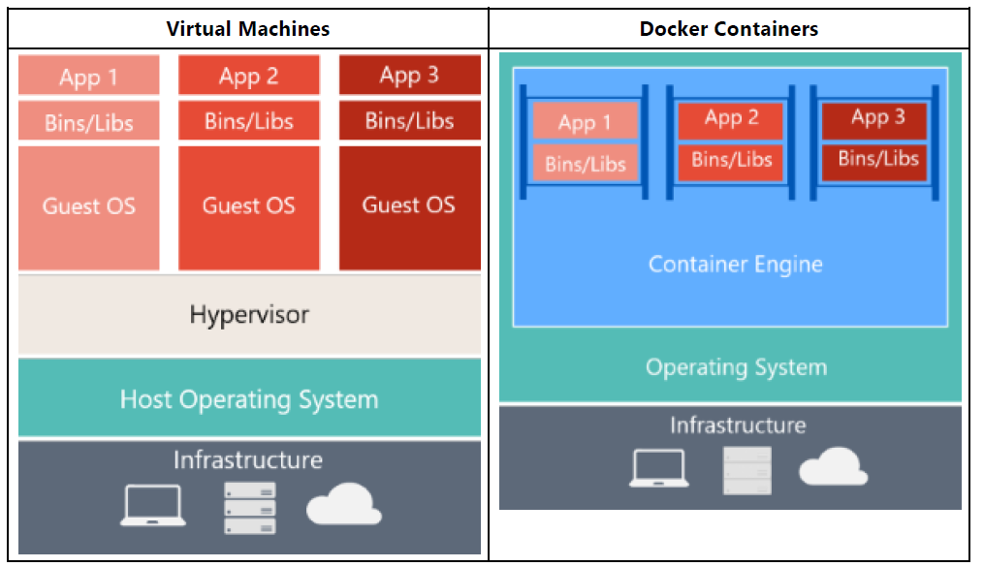
Comparing Docker containers with virtual machines

Slide 10
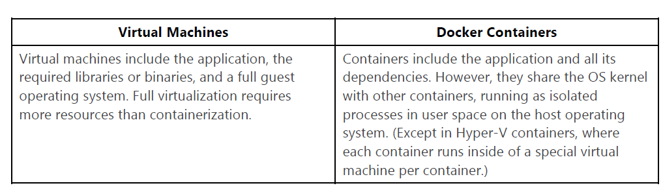
Comparing Docker containers with virtual machines

